Slide 1
Unit - 6
Transport Layer
Prachi Shah
IT Dept.
BVM

Slide 2
Contents
1. | The transport service: Services provided to the upper layers, Transport service primitives, Socket | [Tenanbaum 6.1]
2. | Elements of transport protocols: Addressing, Connection establishment, Connection release, Flow control, Multiplexing, Crash recovery | [Tenanbaum 6.2]
3. | The transport protocol : UDP | [Forouzan 23.2]
4. | The transport protocol : TCP | [Forouzan 23.3]

Slide 3
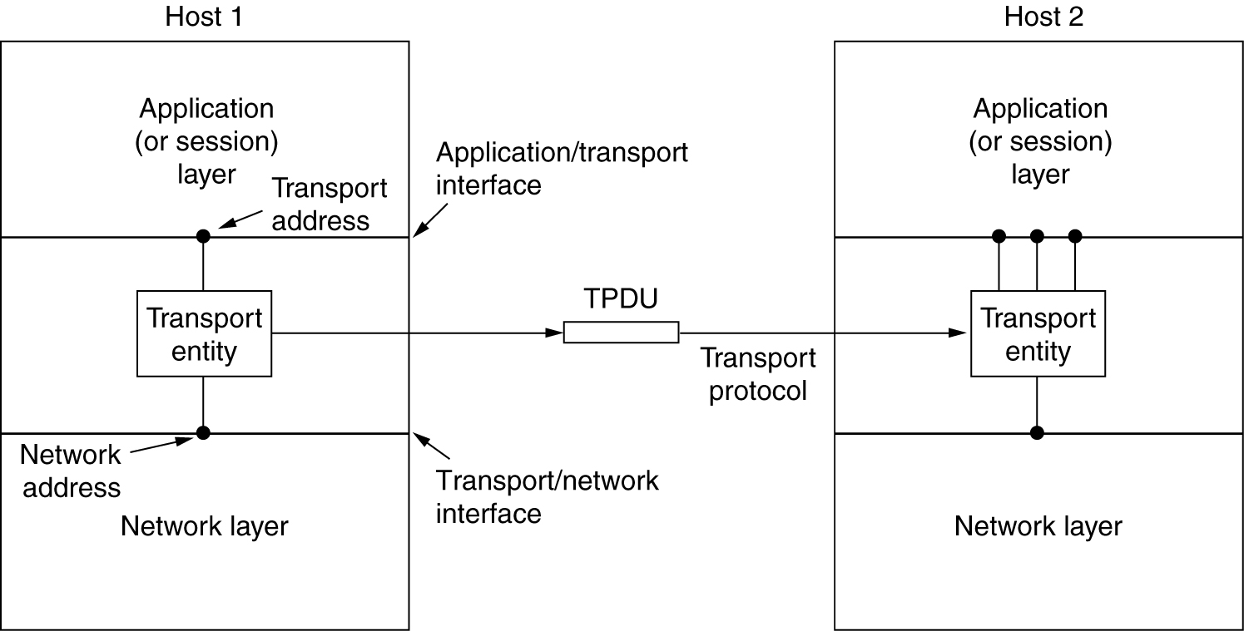
Services Provided to the Upper Layers
The network, transport, and application layers.

Slide 4
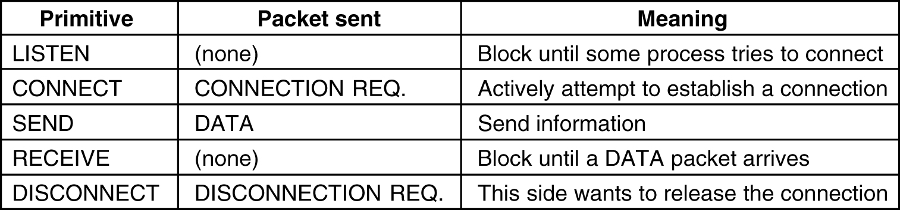
Transport Service Primitives
The primitives for a simple transport service.

Slide 5
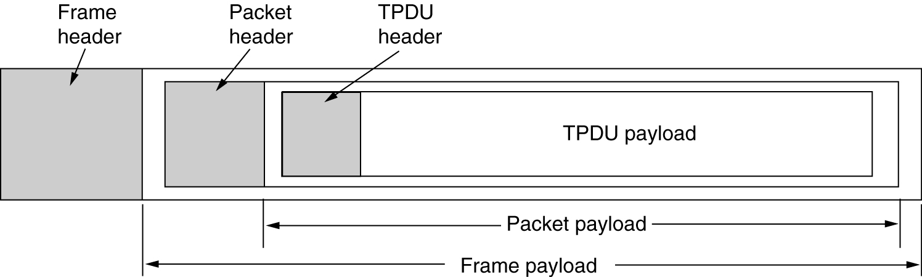
Transport Service Primitives (2)
The nesting of TPDUs, packets, and frames.

Slide 6
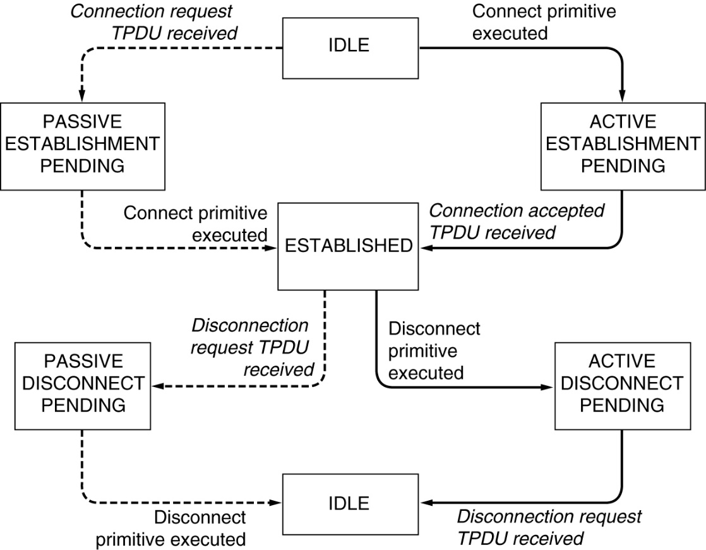
Transport Service Primitives (3)
A state diagram for a simple connection management scheme. Transitions labeled in italics are caused by packet arrivals. The solid lines show the client's state sequence. The dashed lines show the server's state sequence.

Slide 7
Network Socket
A network socket is an endpoint of an inter-process communication flow across a computer network. Today, most communication between computers is based on the Internet Protocol; therefore most network sockets are Internet sockets.
A socket API is an application programming interface(API), usually provided by the operating system, that allows application programs to control and use network sockets. Internet socket APIs are usually based on the Berkeley sockets standard.
A socket address is the combination of an IP address and a port number, much like one end of a telephone connection is the combination of a phone number and a particular extension. Based on this address, internet sockets deliver incoming data packets to the appropriate application process or thread.

Slide 8
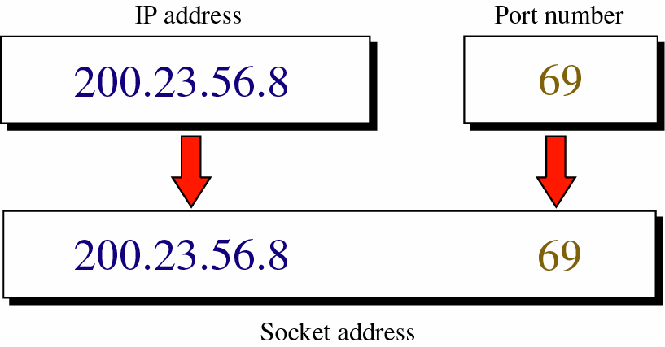
How to create socket address…

Slide 9
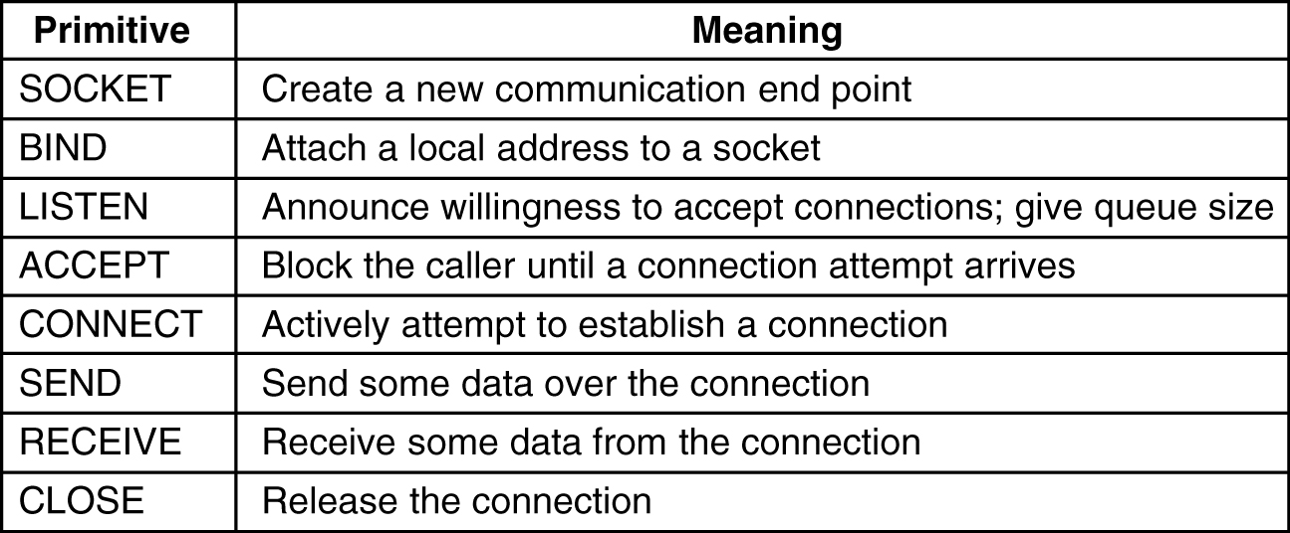
Berkeley Sockets
The socket primitives for TCP.

Slide 10
Elements of Transport Protocols
Addressing
Connection Establishment
Connection Release
Flow Control and Buffering
Multiplexing
Crash Recovery

Slide 11
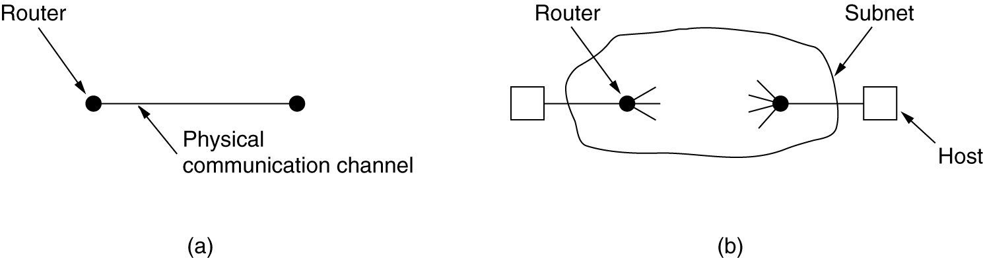
Transport Protocol
(a) Environment of the data link layer.
(b) Environment of the transport layer.

Slide 12
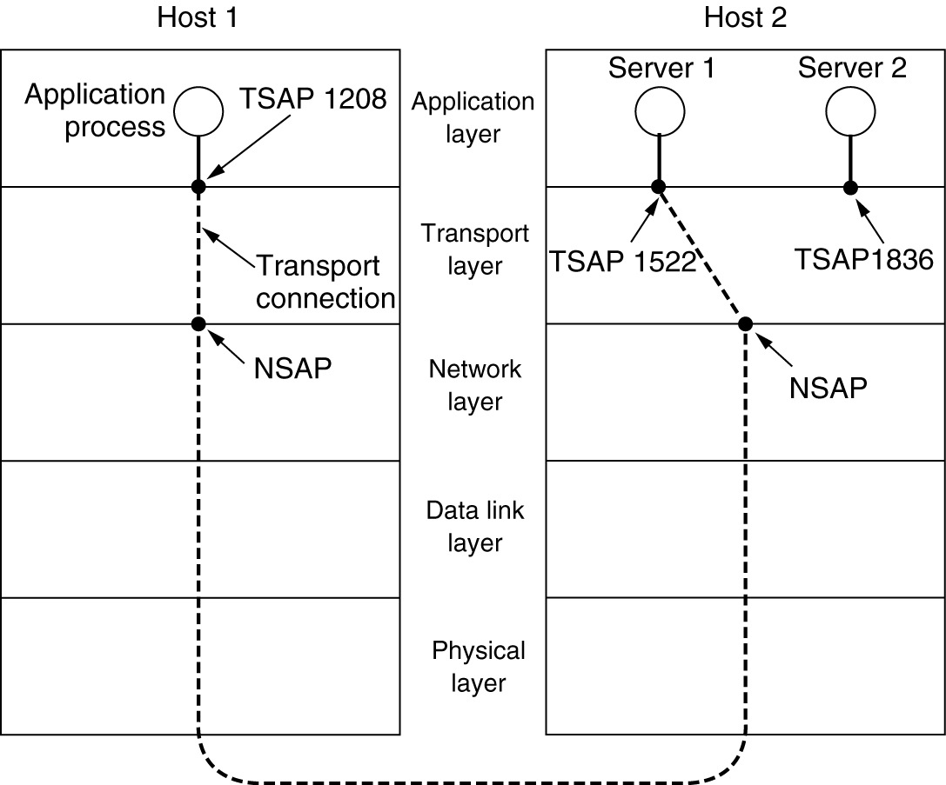
Addressing
TSAPs, NSAPs and transport connections.

Slide 13
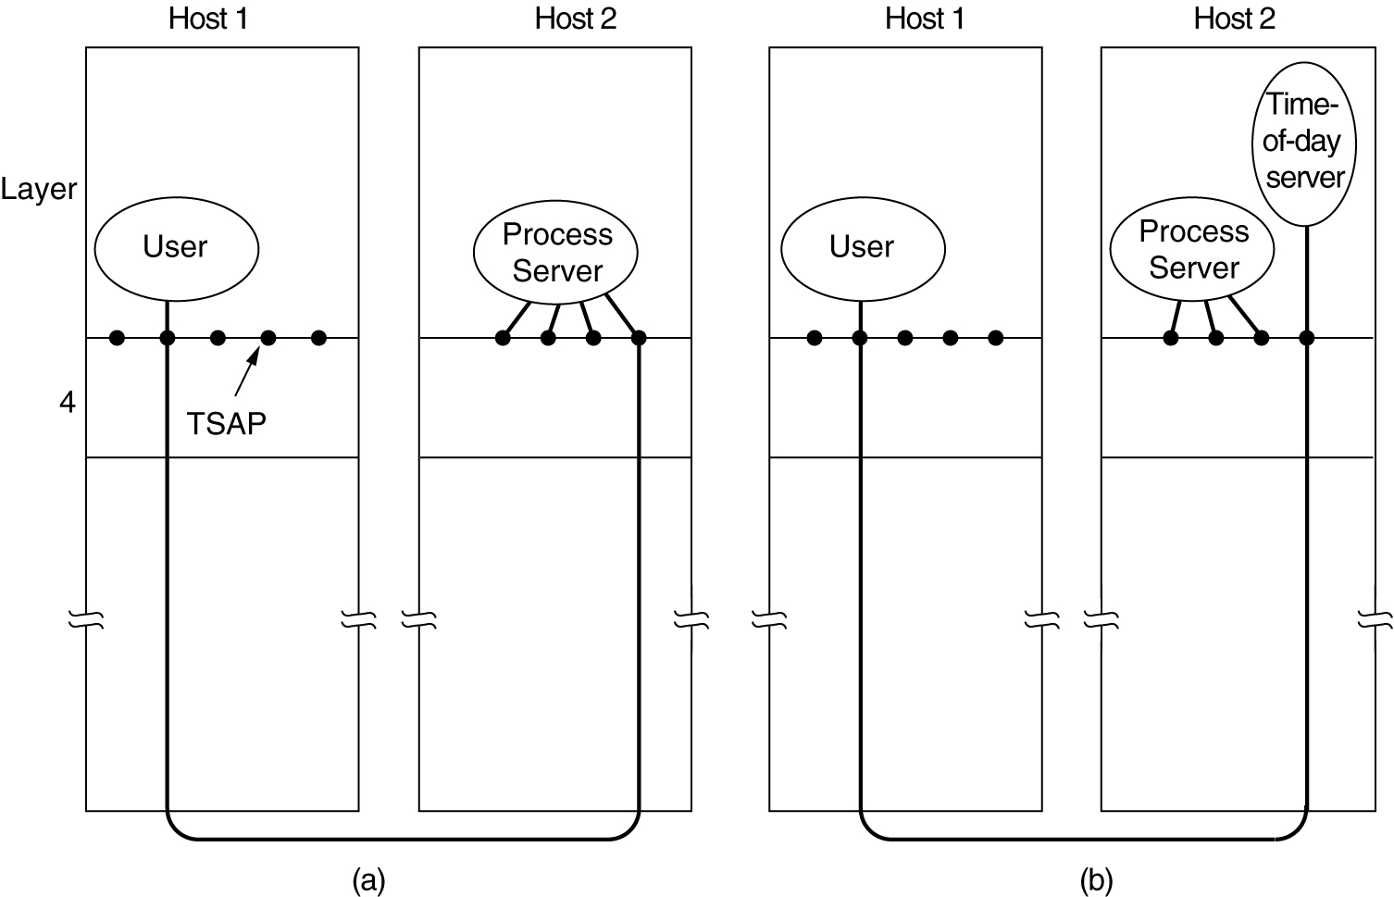
Connection Establishment
How a user process in host 1 establishes a connection with a time-of-day server in host 2.

Slide 14
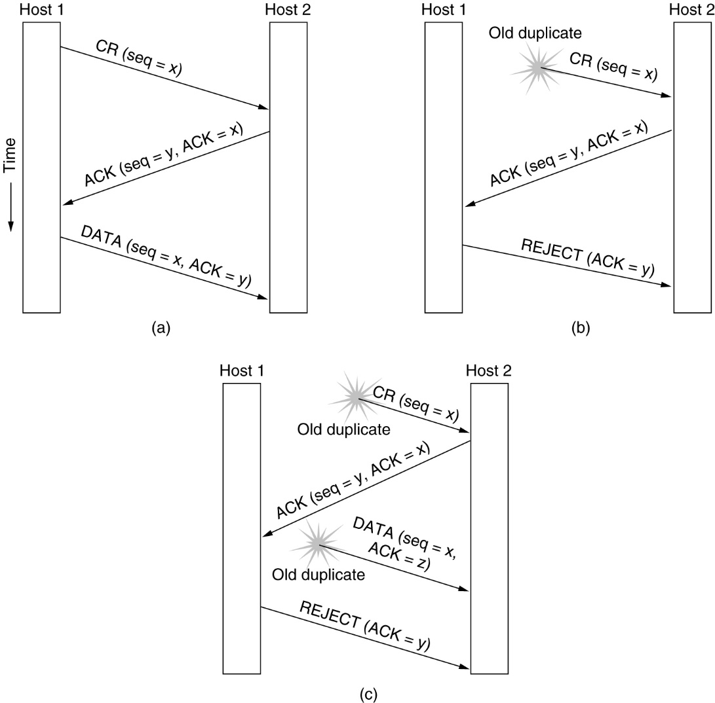
Connection Establishment
Three protocol scenarios for establishing a connection using a three-way handshake. CR denotes CONNECTION REQUEST. (a) Normal operation, (b) Old CONNECTION REQUEST appearing out of nowhere. (c) Duplicate CONNECTION REQUEST and duplicate ACK.

Slide 15
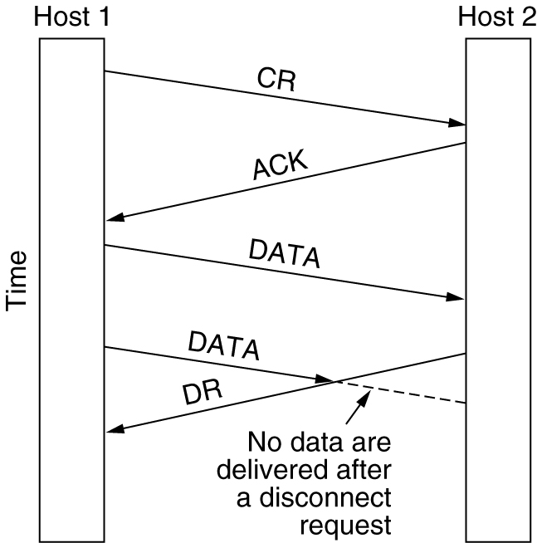
Connection Release
Abrupt disconnection with loss of data.

Slide 16
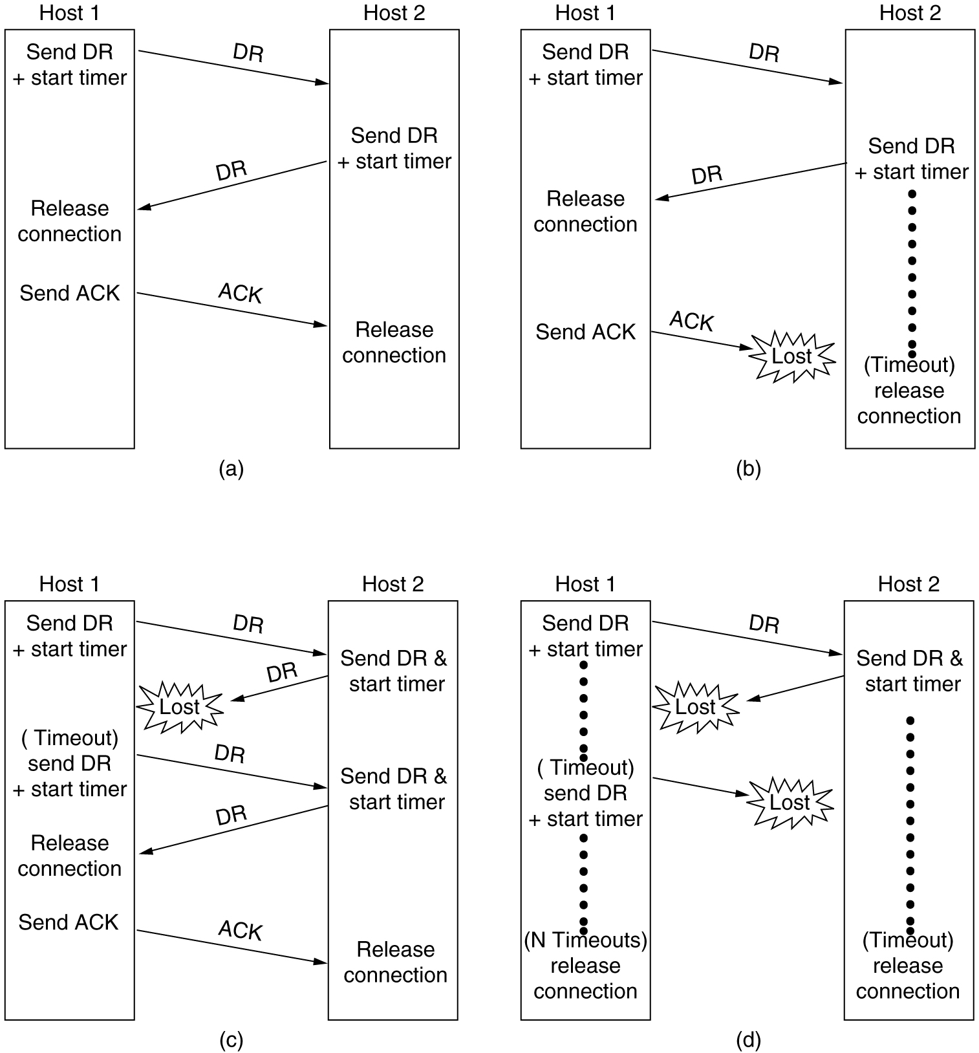
Connection Release
Four protocol scenarios for releasing a connection.
(a) Normal case of a three-way handshake.
(b) final ACK lost.

Slide 17
Connection Release
(c) Response lost.
(d) Response lost and subsequent DRs lost.
6-14, c,d

Slide 18
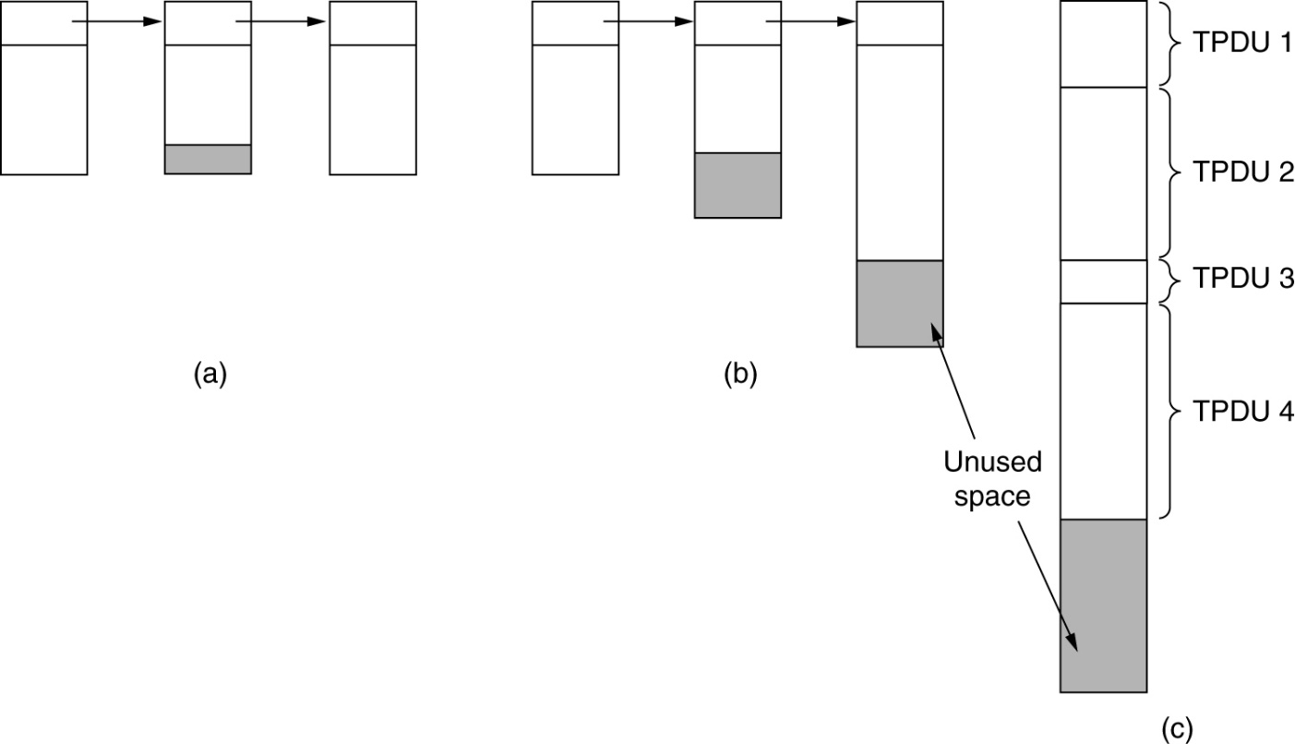
Flow Control and Buffering
(a) Chained fixed-size buffers. (b) Chained variable-sized buffers. (c) One large circular buffer per connection.

Slide 19
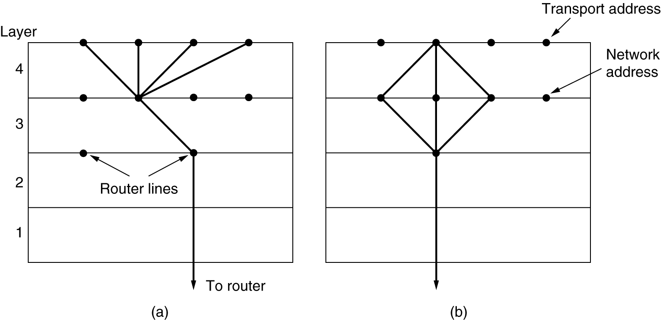
Multiplexing
(a) Upward multiplexing. (b) Downward multiplexing.

Slide 20
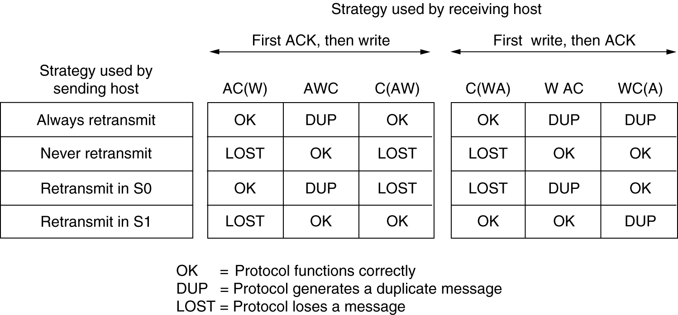
Crash Recovery
Different combinations of client and server strategy.

Slide 21
23-2 USER DATAGRAM PROTOCOL (UDP)
The User Datagram Protocol (UDP) is called a connectionless, unreliable transport protocol. It does not add anything to the services of IP except to provide process-to-process communication instead of host-to-host communication.
Topics discussed in this section:
Well-Known Ports for UDP User Datagram
Checksum
UDP Operation
Use of UDP

Slide 22
Table 23.1 Well-known ports used with UDP

Slide 23
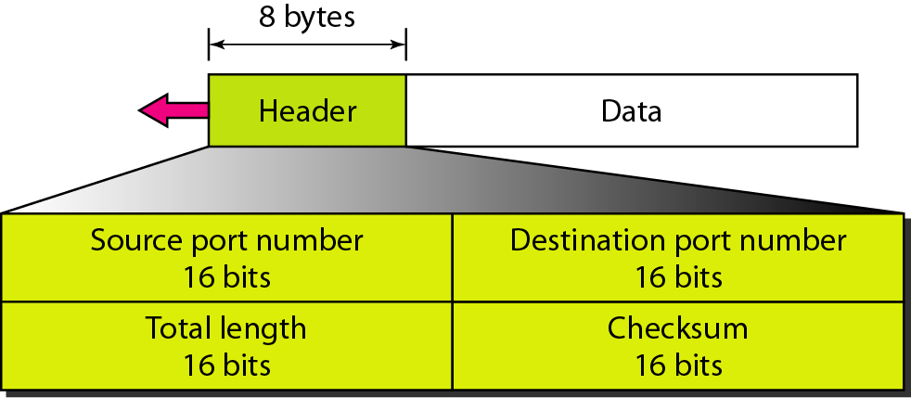
Figure 23.9 User datagram format
Note: UDP length = IP length – IP header’s length

Slide 24
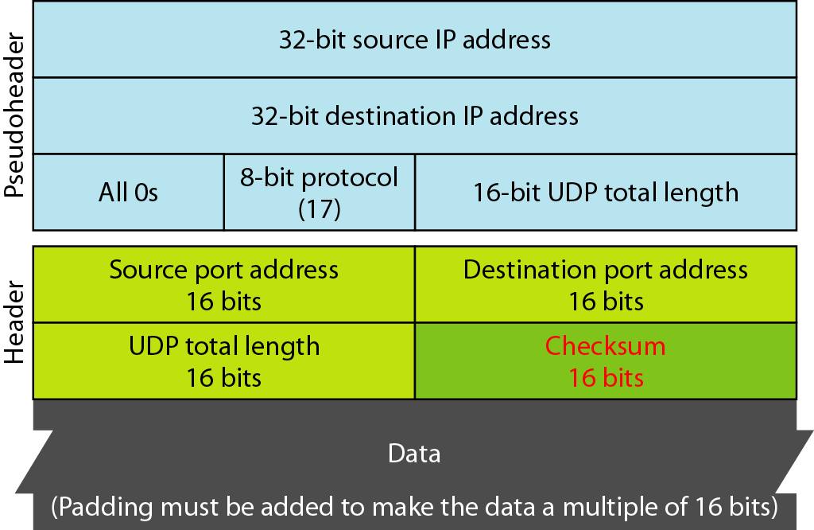
Figure 23.10 Pseudoheader for checksum calculation

Slide 25
Example 23.2
Figure 23.11 shows the checksum calculation for a very small user datagram with only 7 bytes of data. Because the number of bytes of data is odd, padding is added for checksum calculation. The pseudoheader as well as the padding will be dropped when the user datagram is delivered to IP.

Slide 26
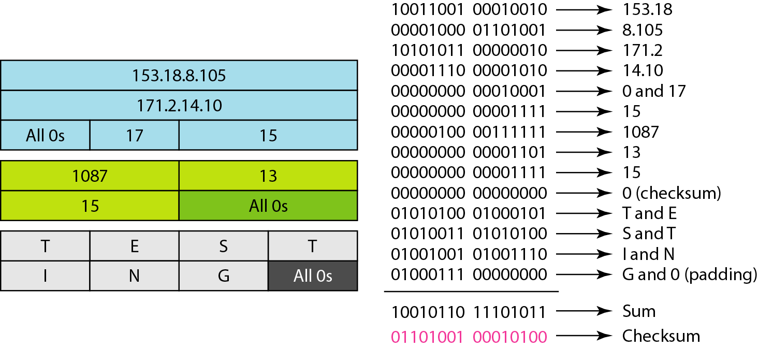
Figure 23.11 Checksum calculation of a simple UDP user datagram

Slide 27
UDP Operations & Uses
Operations:
Connectionless Services – can send only short messages
No Flow and Error Control
Encapsulation and Decapsulation
Queuing
Uses:
For a process that requires simple request-response communication
For a process with internal flow and error control mechanisms
For multicasting
For management processes
For some route updating protocols

Slide 28
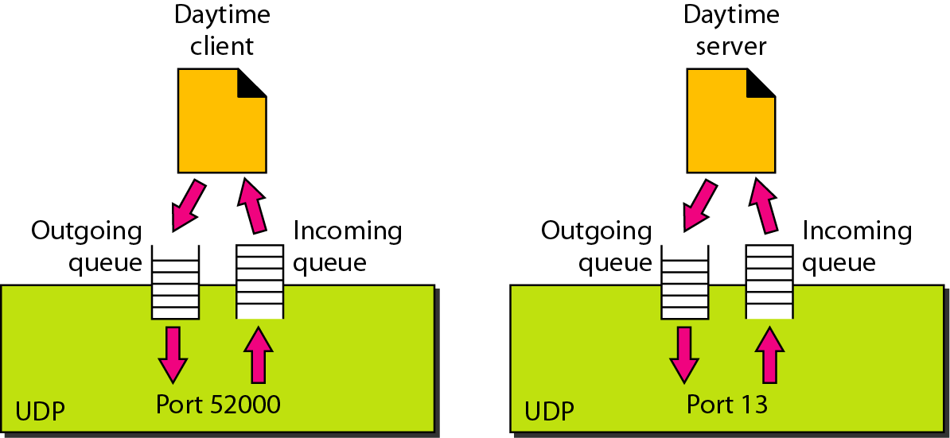
Figure 23.12 Queues in UDP

Slide 29
23-3 TCP
TCP is a connection-oriented protocol; it creates a virtual connection between two TCPs to send data. In addition, TCP uses flow and error control mechanisms at the transport level.

Slide 30
Table 23.2 Well-known ports used by TCP

Slide 31
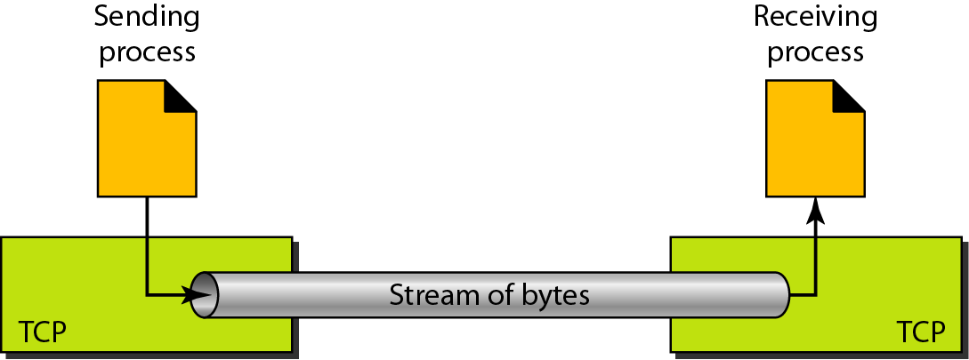
Figure 23.13 Stream delivery

Slide 32
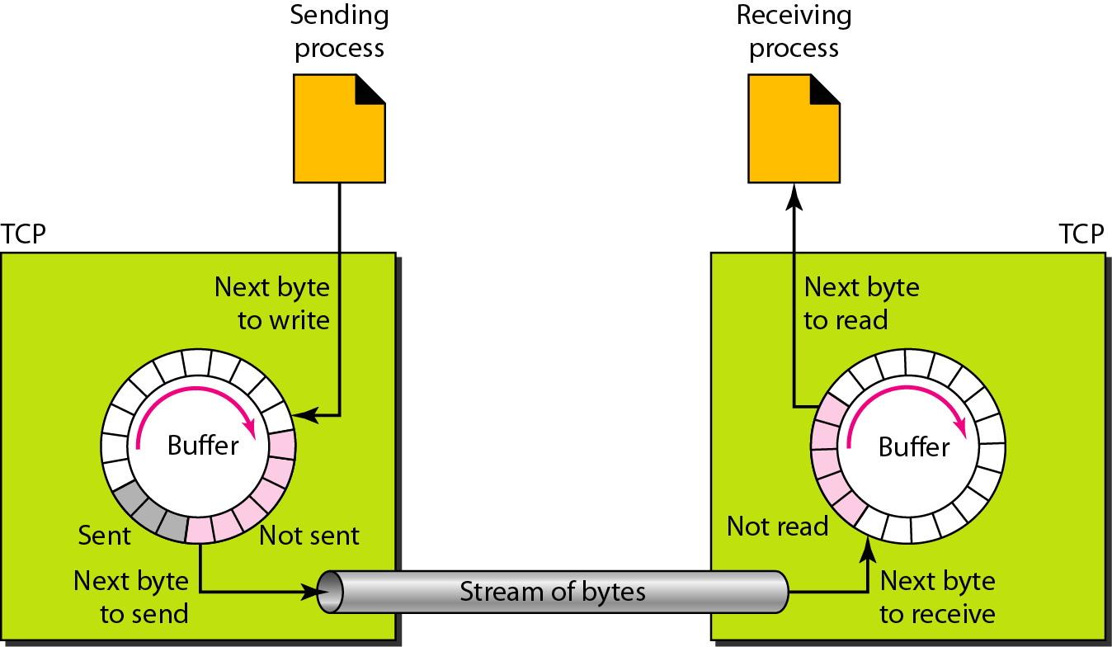
Figure 23.14 Sending and receiving buffers

Slide 33
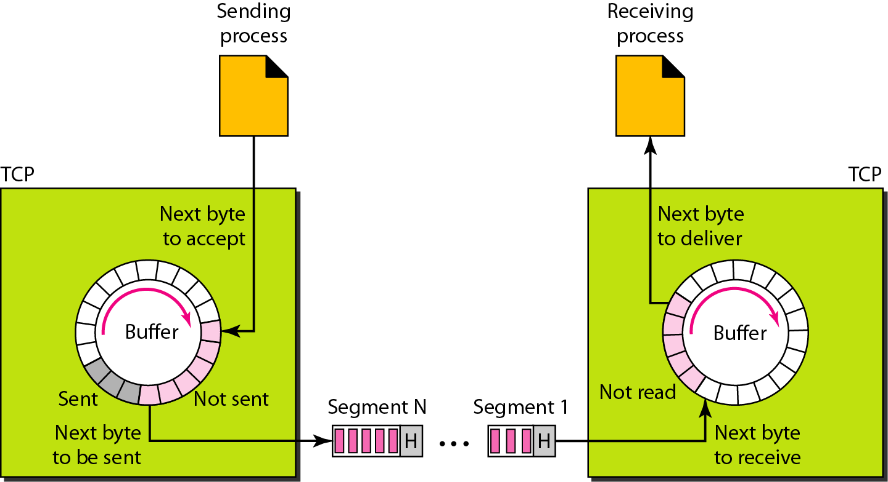
Figure 23.15 TCP segments

Slide 34
TCP Features – Numbering System
The bytes of data being transferred in each connection are numbered by TCP.
The numbering starts with a randomly generated number.
The value in the sequence number field of a segment defines the number of the first data byte contained in that segment.
The value of the acknowledgment field in a segment defines the number of the next byte a party expects to receive. The acknowledgment number is cumulative.

Slide 35
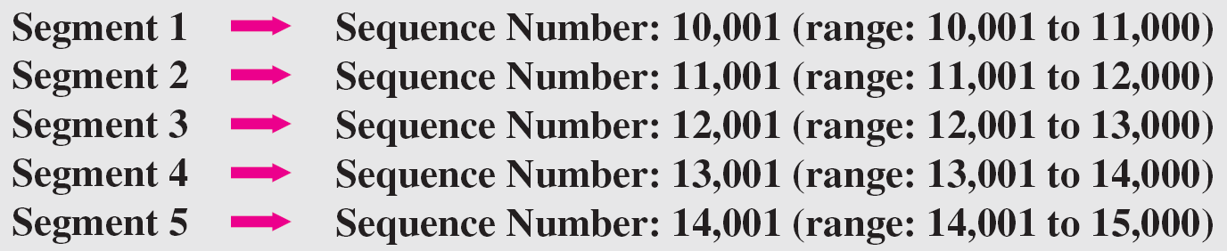
Example 23.3
The following shows the sequence number for each segment:

Slide 36
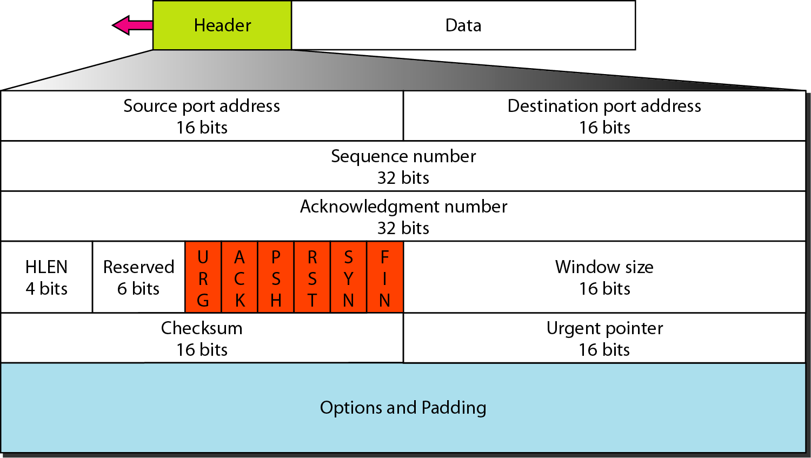
Figure 23.16 TCP segment format

Slide 37
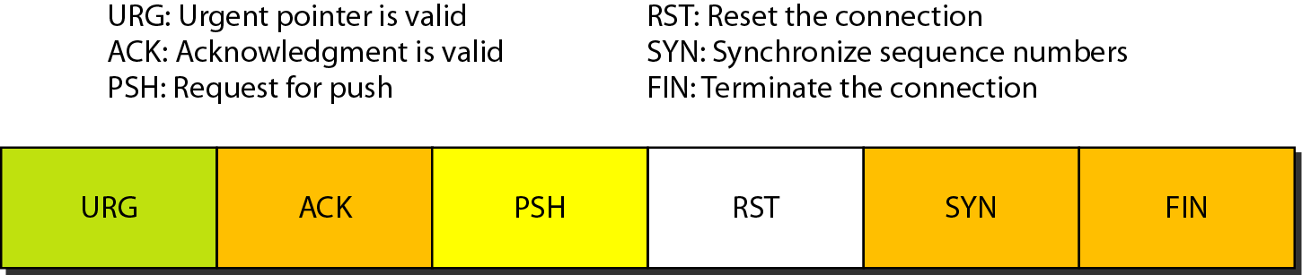
Figure 23.17 Control field
Table 23.3 Description of flags in the control field

Slide 38
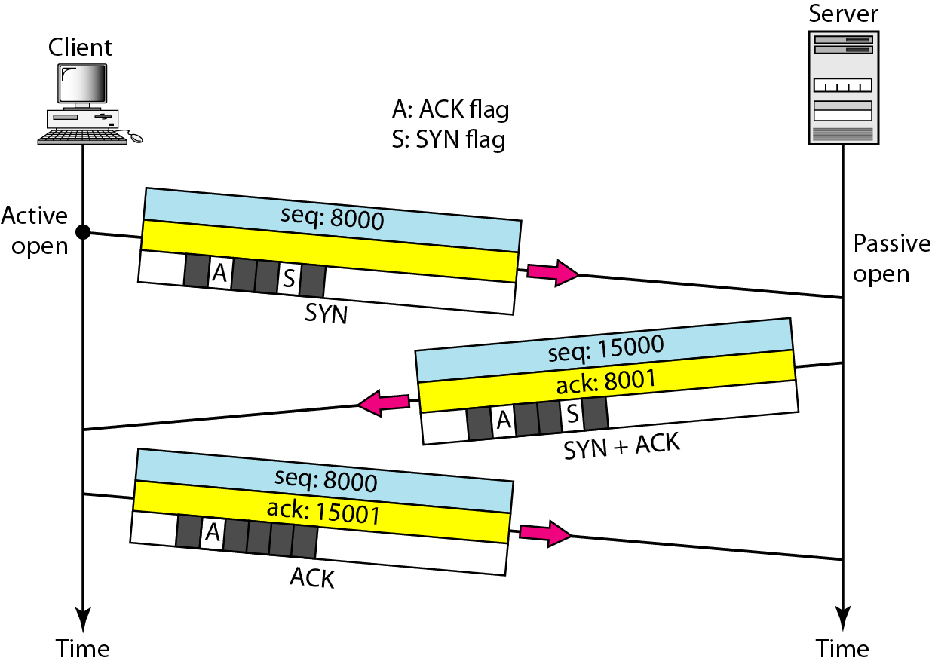
Figure 23.18 Connection establishment using three-way handshaking

Slide 39
A SYN segment cannot carry data, but it consumes one sequence number.
A SYN + ACK segment cannot carry data, but does consume one sequence number.
An ACK segment, if carrying no data, consumes no sequence number.

Slide 40
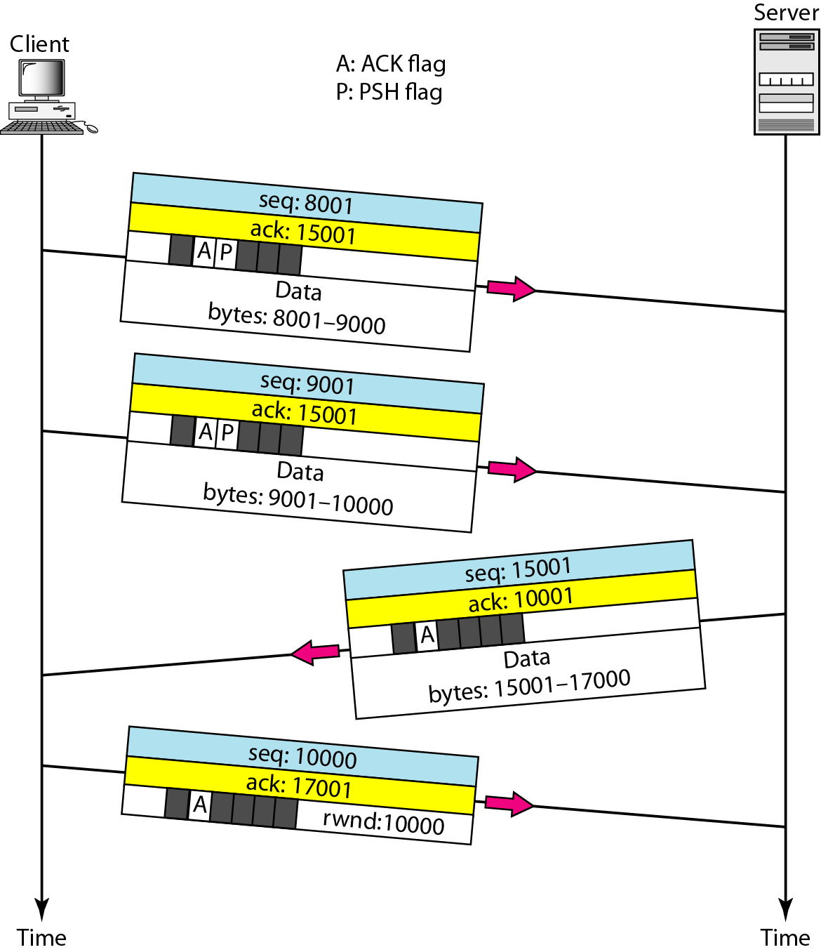
Figure 23.19 Data transfer

Slide 41
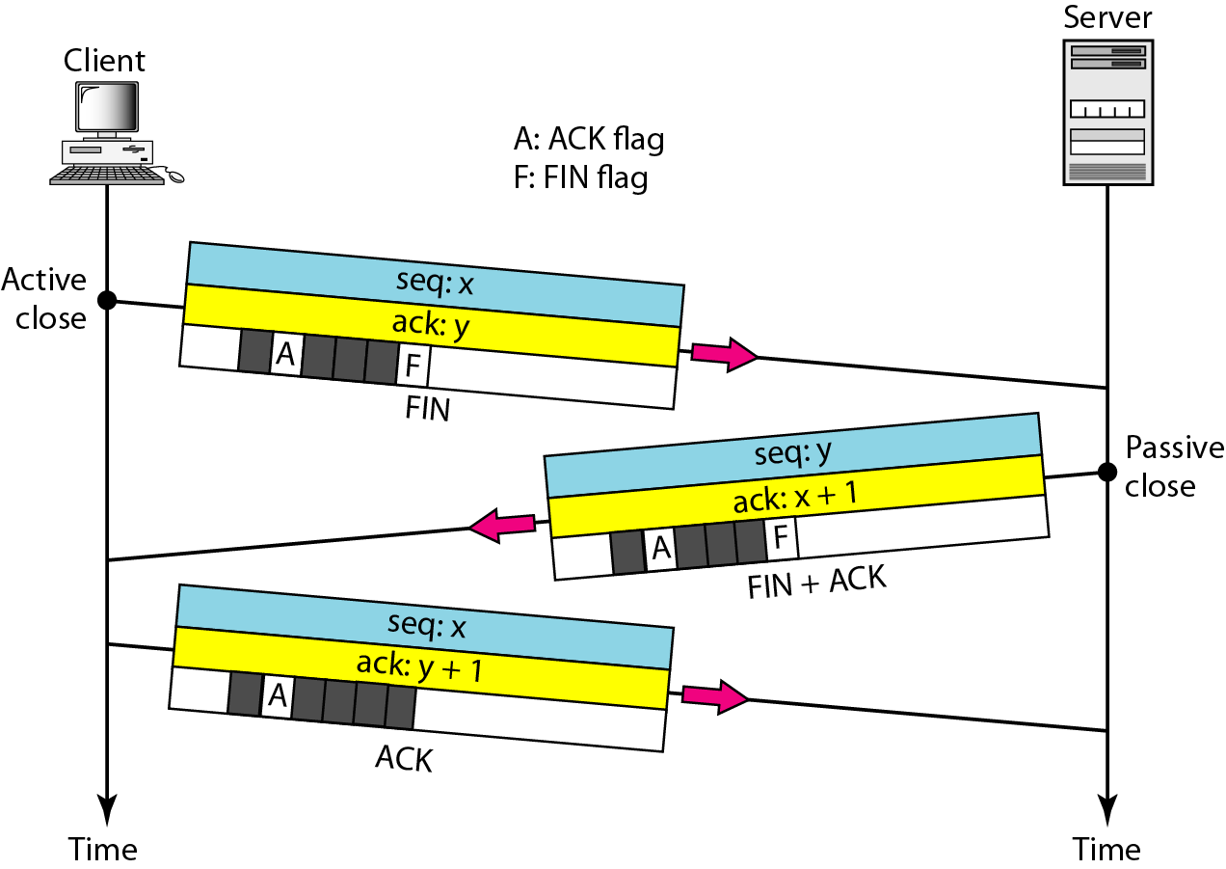
Figure 23.20 Connection termination using three-way handshaking

Slide 42

Note
The FIN segment consumes one sequence number if it does not carry data.
The FIN + ACK segment consumes one sequence number if it does not carry data.

